Slide 1

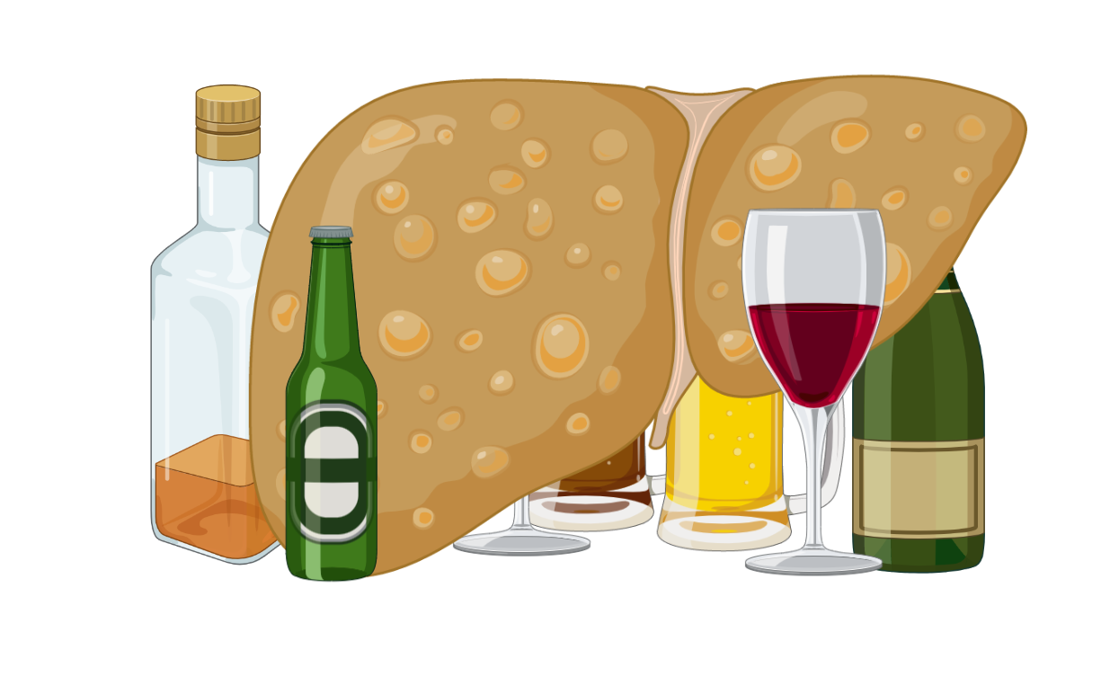
Spectrum
Alcohol-related Liver Disease
Diagnosis
Management
AH
Cases

Slide 2
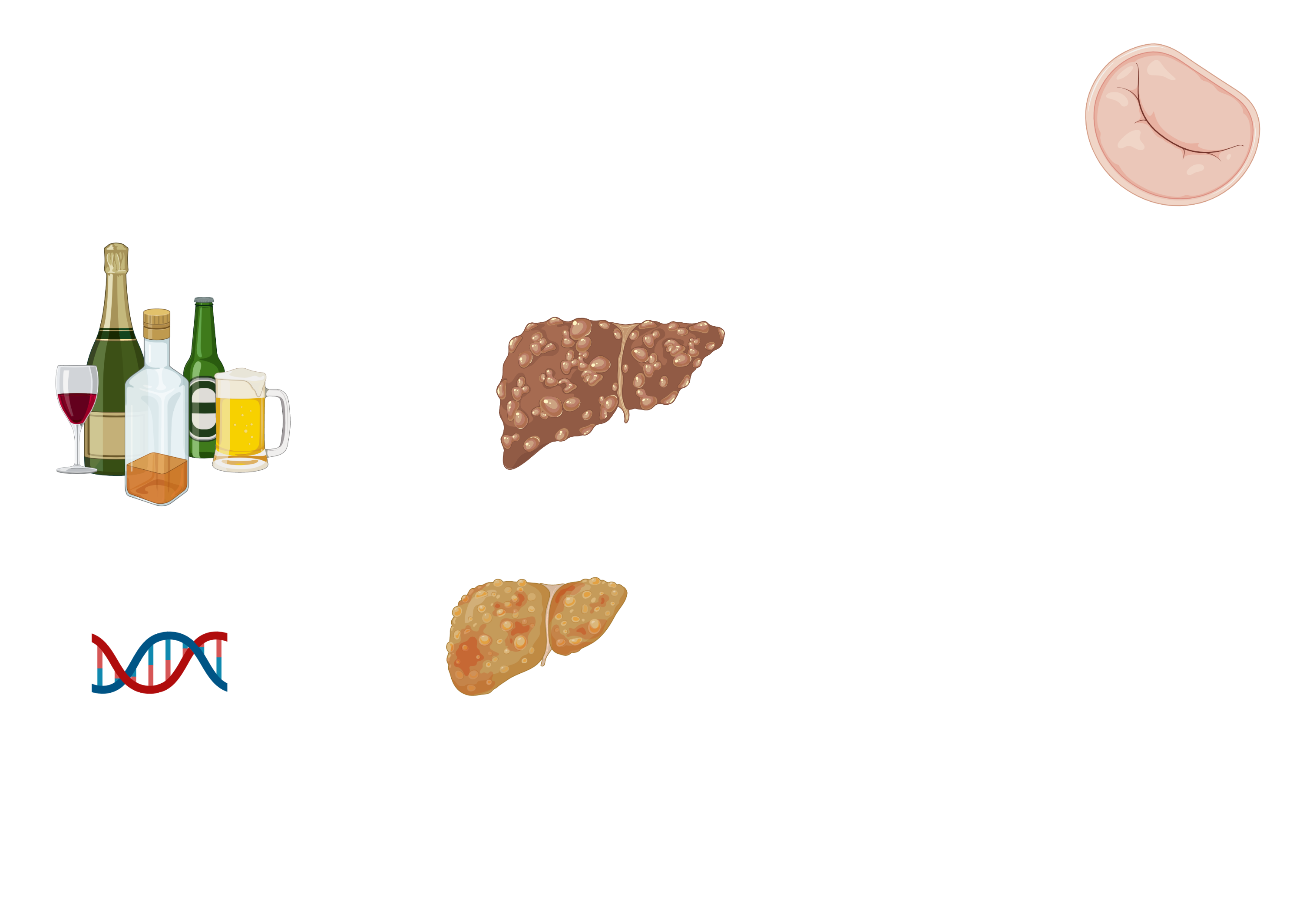

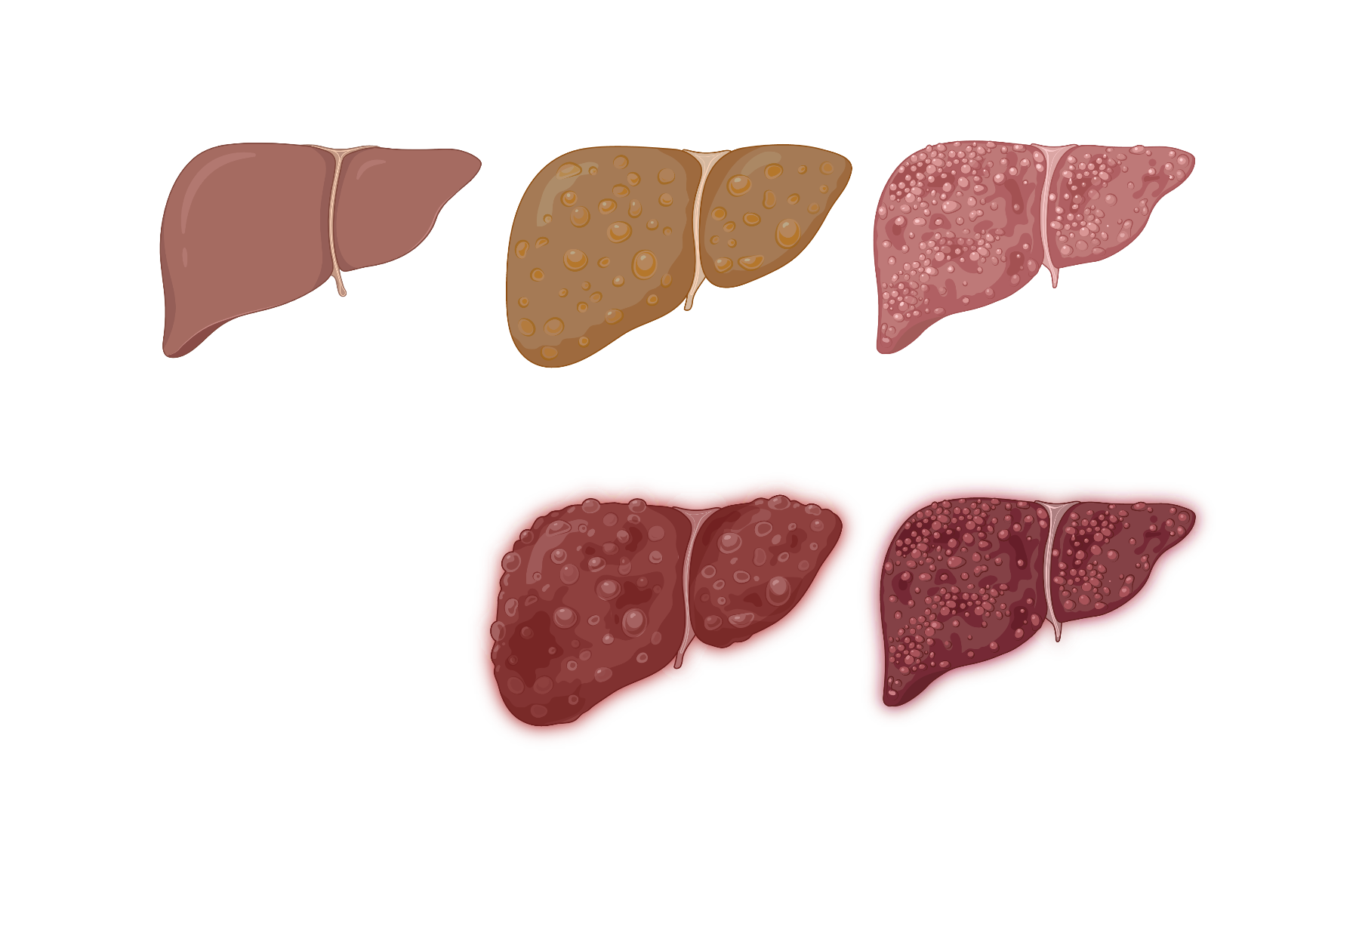
Spectrum
Overview / Spectrum of Disease
Diagnosis
Other liver disease
Viral hepatitis
NASH
Risk factors
Risk factors
Volume
(M: ≥3 /d | F: ≥2 /d)
Pattern (e.g., binging)
Management
Genetics
AH
ETOH use
Cases
ETOH-related hepatitis
(Steatohepatitis)
ETOH-related fatty liver disease
(Hepatic steatosis)
ETOH-related hepatitis
(Steatohepatitis)
ETOH-related fatty liver disease
(Hepatic steatosis)
Normal liver
Normal liver
Cirrhosis
Cirrhosis
ETOH use
ETOH use
ETOH use
Acute onset symptomatic hepatitis
Acute decompensation occurs with ongoing ETOH use
Images created with Biorender.com
Notes:
Diagnosis and Treatment of Alcohol‐Associated Liver Diseases: 2019 Practice Guidance From the American Association for the Study of Liver Diseases (wiley.com) https://aasldpubs.onlinelibrary.wiley.com/doi/epdf/10.1002/hep.30866

Slide 3
Overview
Diagnostic Evaluation
Diagnosis
How to screen?
Who to screen?
How to screen?
Who to screen?
Management
Screen all > 18 yo with unhealthy ETOH use
RUQ US
LFTs, CBC, INR
AH
ETOH use
Cases
ETOH-related fatty liver disease
(Hepatic steatosis)
ETOH-related hepatitis
(Steatohepatitis)
Normal liver
Cirrhosis
ETOH use
ETOH use
ETOH use
Diagnosis
Diagnosis
Diagnosis
Diagnosis
Diagnosis
Diagnosis
Diagnosis
Often incidental finding on imaging
± ↑ LFTs
Indistinguishable from NAFLD on US or biopsy
Clinical diagnosis!
Typically, AST:ALT is > 2
↑ LFTs increases likelihood of steatohepatitis
Risk scores (e.g, APRI, FibroTest, ELF)
Small nodular liver on US
Elastography
Liver biopsy
Images created with Biorender.com
Notes:
Thiele M, et al. Accuracy of the enhanced liver fibrosis test vs FibroTest, elastography, and indirect markers in detection of advanced fibrosis in patients with alcoholic liver disease. Gastroenterology 2018;154:1369-1379.
289 patients with alcoholic liver disease
Investigated liver biopsy, enhanced liver fibrosis (ELF), FibroTest, and elastography
Compared the accuracy of these tests in detection of advanced liver fibrosis
ELF and FibroTest identified advanced liver fibrosis in alcoholic patients from primary and secondary care with high diagnostic accuracy. (Fibrotest value below 0.58 rules out advanced fibrosis).
The impact of liver disease aetiology and the stages of hepatic fibrosis on the performance of non-invasive fibrosis biomarkers: an international study of 2411 cases - PubMed (nih.gov)
https://pubmed.ncbi.nlm.nih.gov/21981787/
Non-invasive assessment of liver fibrosis in alcoholic liver disease PMID: 32728629
Cross sectional study of 130 cases with ALD
Validated TE

Slide 4
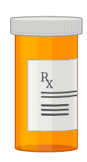
Spectrum
Management
Diagnosis
Medications
Psychosocial interventions
Alcohol cessation
Naltrexone (IM/PO)
Acamprosate (PO)
Others (disulfiram, baclofen, gabapentin)
Mutual help groups
Psychotherapy
Residential treatment
Alcohol cessation
Management
AH
↓disease progression
Cases
ETOH-related fatty liver disease
(Hepatic steatosis)
ETOH-related hepatitis
(Steatohepatitis)
Normal liver
Cirrhosis
ETOH use
ETOH use
ETOH use
ETOH use
Dietary changes
High protein diet + folate, B12, B1 supplementation
Dietary changes
Liver transplant
Considered for select patients with complications
Liver transplant
Images created with Biorender.com

Slide 5


Spectrum
Diagnosis of Alcohol-related Hepatitis (AH)
Diagnosis
Management
Clinical features
Clinical features
Diagnostic work-up
Diagnostic work-up
AH
Fever
RUQ pain
Anorexia
Ascites
Jaundice (≤8 wks)
Rule out other causes of hepatitis
Acute hepatitis panel
Drug screen and APAP level
RUQ US with doppler
Liver biopsy (rarely needed)
Diagnosis
Treatment
Heavy, recent ETOH use
Heavy, recent ETOH use
Cases
Laboratory findings
Diagnosis
Laboratory findings
>4 /d
>3 /d
↑ AST:ALT >2 (usually <400 IU/L)
↑ Total bilirubin >3 mg/dL
↑ GGT
↑ WBC (PMN predominant)
↑ INR
<60 d of abstinence prior to onset of jaundice
AASLD Guideline for clinical diagnosis of AH
Images created with Biorender.com

Slide 6
Spectrum
Management of Alcohol-related Hepatitis
MDF≥32 or MELD≥20
MDF uses INR and Tbili to predict short term mortality
Diagnosis
MDF≥32 or MELD ≥20
Management
no
yes
High risk
Mortality 30-50% at 30 d
Lower risk
High risk
Mortality 30-50% at 30 d
AH
Lower risk
AKI with Cr >2.5 mg/dL
Uncontrolled GIB
Multiorgan failure/ shock
Alternative cause
Evidence of infection
Diagnosis
Hospital admission depending on severity
Exclusion criteria?
Treatment
yes
no
Cases
Alcohol cessation
Address nutrition
Manage complications
DC beta-blockers
Prednisolone?
Prednisolone?
Controversial & institution dependent
No mortality benefit after 28 d
Lille score at 4-7d
Lille score at 4-7d
<0.45
>0.45
DC steroids
Palliative care
Liver transplant
Complete 28 d course
Notes:
MELD can be considered (MELD >20)

Slide 7
Spectrum
Case 1a
Case 1b
Diagnosis
60-year-old M with history of HTN presents for an annual wellness visit. His only medication is lisinopril 10mg. He drinks a 6-pack of beers every night. He is a never smoker and has no history of drug use.
Exam: BP 129/78, P 75, SpO2 94%, BMI 28. Physical exam is notable for hepatomegaly.
Labs:
WBC 8, Hgb 14, plts 208
AST 80, ALT 55, ALP 110, Tbili 0.9, and INR 1.1.
Negative HCV antibody within the past year.
He is abstinent for 3 months and returns to see you in clinic.
Labs:
WBC 8, Hgb 14, plts 108
AST 87, ALT 65, ALP 118, Tbili 0.9, and INR 1.5.
Management
ETOH hep
What are the next best steps for evaluation of his abnormal LFTs?
Cases
US assesses degree of liver disease and complications.
A) RUQ US
Further evaluation is needed beyond lab monitoring given ↑ APRI and ↑ INR.
B) Repeat labs in 3-6 months
1
What are the next best steps for evaluation/management of his abnormal LFTs?
C) Calculate APRI
APRI can help screen for cirrhosis in ETOH-related liver disease.
Referral is not necessary at this time.
2
D) Refer to Hepatology
Elevated LFTs likely from heavy alcohol use. LFTs and hepatomegaly may normalize with abstinence.
A) RUQ US
Repeat labs at 3-6 months after a period of abstinence.
B) Repeat labs in 3-6 months
…RUQ US shows a small, nodular liver with splenomegaly. No ascites is seen.
He has alcohol use disorder. Counsel on alcohol cessation. Offer meds to help with abstinence.
What is your next step in management?
C) Discuss alcohol cessation
Referral may not be necessary at this time (though practice can be institution/provider dependent).
D) Refer to Hepatology
Refer to Hepatology.
Nutritional counseling (high protein diet, vitamin supplementation)
Continued abstinence counseling.
Health maintenance (viral hepatitis testing and vaccination, EGD for varices, routine HCC screening)

Slide 8
Overview
Case 2a
Case 2b
Diagnosis
35-year-old F presents with 1 week of progressive jaundice, new onset ascites, and dyspnea on exertion. She drinks on average 3-4 alcohol containing drinks per night and occasionally binge drinks. Last drink ~24 h ago. No other substance use. No medications or supplements.
Exam: T 37.9C, HR 90, BP 120/88, RR 20, SpO2 94% on RA. Jaundiced, has a distended abdomen with fluid wave present, and 2+ lower extremity edema extending to the knees bilaterally. Confused with asterixis.
Labs:
Cr 0.82, BUN 11, WBC 14, Hgb 11, plts 108
AST 224, ALT 110, ALP 118, Tbili 3.4, and INR 2.1.
RUQ US with enlarged fatty liver and moderate volume ascites.
Evaluation for infection including CXR, UA, and SBP is negative.
What is the next best step in management?
Management
The MDF is 94, which is associated with high short-term mortality. Given that there are no contraindications (normal renal function, no GIB, infection ruled out), then steroids could be considered.
ETOH hep
Cases
…She is started on prednisolone 40 mg daily.
1
When should she be re-evaluated for response to therapy?
2
Repeat CMP and coags should be obtained at 4-7 days after starting steroid therapy to assess response. The Lille score can help determine response to and duration of therapy.
What is the most likely diagnosis?
…After 7 days, repeat labs show:
Cr 0.78, BUN 8, WBC 12, Hgb 11, plts 98
AST 204, ALT 78, ALP 130, Tbili 4.4, and INR 1.8 (PT 20).
Albumin 2.7
The liver is enlarged, which is less consistent with cirrhosis.
A) Decompensated cirrhosis
There are signs of acute hepatitis superimposed on steatosis.
B) Alcohol-related steatosis
What is the next best step in management?
This patient should be ruled out for any infections including SBP. AH can also cause fever and WBC.
C) Spontaneous bacterial peritonitis
AST:ALT >2 with levels <300s, ↑Tbili. AH can be complicated by ascites, encephalopathy, varices.
D) Alcohol-related steatohepatitis
Lille score is <0.45, this suggests good prognosis and response to steroids. Six-month survival is 85%. Steroids should be continued for 28 d total.

Slide 9
Management of Alcohol-induced Hepatitis
ETOH use
Normal liver
ETOH use
ETOH use
ETOH use
Diagnosis
Treatment

Slide 10
Management of Alcohol-induced Hepatitis
ETOH use
ETOH-related fatty liver disease
(Hepatic steatosis)
ETOH-related hepatitis
(Steatohepatitis)
Normal liver
ETOH use
ETOH use
ETOH use
Often incidental finding
± ↑ LFTs
Indistinguishable from NAFLD on US or biopsy
Clinical diagnosis!
AST:ALT is >2 and <400
Tbili >3
Heavy ETOH use within 60 d
May have fever, ↑WBC, RUQ pain, ascites
Risk scores (APRI, FibroTest, ELF)
Small nodular liver
Elastography
Liver biopsy
Diagnosis
Risk stratify (MDF, MELD)
±prednisolone if MDF≥32
Treatment
Alcohol cessation
Diet

Slide 11
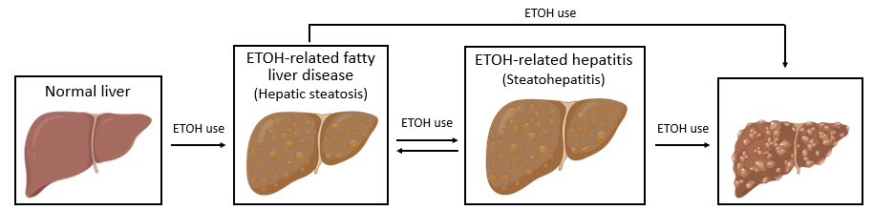

Slide 12
Guideline & Nomenclature Update (2024)
2024 ACG Clinical Guideline on Alcohol-Associated Liver Disease (Am J Gastroenterol 2024;119:30-54)
• Reaffirms the framework taught here: abstinence is the single most effective intervention; MDF ≥32 (or MELD >20) identifies severe alcohol-associated hepatitis (AH) for corticosteroid consideration; Lille score at day 4–7 guides whether to continue or stop.
• Prednisolone 40 mg/day improves 28-day (short-term) survival in severe AH without contraindications — no long-term benefit. Adding IV N-acetylcysteine (NAC) to prednisolone may further improve short-term (28–30 day) survival.
• Early liver transplantation for carefully selected patients with severe AH non-responsive to medical therapy is now endorsed by ACG/AASLD (no longer experimental), with outcomes comparable to other indications.
• 2023 multi-society nomenclature change (Hepatology 2023;78:1966): NAFLD → MASLD, NASH → MASH; new "MetALD" category for metabolic dysfunction plus moderate alcohol use. "Alcohol-related steatosis is indistinguishable from MASLD on imaging" replaces the old NAFLD wording on the diagnosis slides.
Standing teaching slides are unchanged and remain current; this slide captures the newer framing and adjuncts.

Slide 13
Take-Home Points
• ALD is a spectrum: hepatic steatosis → alcohol-related (steato)hepatitis → fibrosis/cirrhosis. Steatosis and inflammation can regress with abstinence; fibrosis is largely irreversible.
• Abstinence is the single most important factor improving survival. Use a multimodal approach: naltrexone or acamprosate first-line (FDA-approved), plus psychosocial/behavioral treatment. Avoid disulfiram in ALD.
• Alcohol-related hepatitis (AH) is a CLINICAL diagnosis: heavy recent use, jaundice ≤8 wks, AST:ALT >2 with both <400 IU/L, total bilirubin >3 mg/dL. Rule out infection and other causes in every patient.
• Risk-stratify AH with MDF (≥32) or MELD (>20). Consider prednisolone 40 mg/day (± NAC) if no contraindication (active infection, AKI Cr >2.5, GI bleed, multiorgan failure). Reassess with Lille at day 4–7: <0.45 = continue 28-day course; ≥0.45 = stop steroids.
• Nutrition matters: high-protein diet with thiamine, folate and B-complex supplementation. Refer non-recovering cirrhosis — and selected severe AH — for transplant evaluation.

Slide 14
Attribution, License & Changelog
Adapted from the TeachIM original "Alcohol-related Liver Disease" (published November 2022).
• Authors: CJ Mowry, MD; John Haydek, MD. Section Editor: Elijah Mun, MD. Executive Editor: Yilin Zhang, MD.
• Source: https://teachim.org/teaching_material/alcohol-related-liver-disease/
• License: Creative Commons Attribution-NonCommercial 4.0 International (CC BY-NC 4.0). Non-commercial educational use only.
• Optimization (June 2026): surgical correction — Case 2b slide "Six-month mortality is 85%" → "survival is 85%" (Lille <0.45 predicts ~85% 6-month survival; Louvet, Hepatology 2007). All original click-to-reveal animations and BioRender graphics preserved.
• Added: 2024 ACG ALD guideline update + 2023 MASLD/MASH nomenclature slide; take-home slide. Companion files: ALD facilitator guide (ALD-teaching-script.pdf), ALD learner handout (ALD-handout.pdf) — reviewed, no changes needed.
Medical content should be clinician-reviewed before teaching.

